Slide 1
Docker Training

Slide 2
Docker Introduction
Docker is an open-source containerization platform that allows developers to package applications and dependencies into lightweight, portable containers. These containers ensure that the application runs consistently across different environments.
Works on any system (Linux, Windows, macOS)
Eliminates “It works on my machine” issues
Lightweight and fast compared to virtual machines (VMs)
Easily scalable and portable

Slide 3
Docker Commands
Action | Command
Check installed Docker version | docker --version
List running containers | docker ps
List all containers | docker ps -a
Download an image | docker pull <image-name>
Run a container | docker run -d -p 8080:80 <image-name>
Stop a container | docker stop <container-id>
Remove a container | docker rm <container-id>
Remove an image | docker rmi <image-name>

Slide 4
Docker Vs Virtual Machine
Feature | Docker (Containers) | Virtual Machines (VMs)
Startup Time | Seconds | Minutes
Performance | Lightweight | Heavy (due to OS overhead)
Portability | Runs anywhere | Platform-dependent
Storage | Small (~MBs) | Large (~GBs)
Isolation | Process-level | Full OS-level

Slide 5
images
A Docker image is a file that contains the instructions for building a Docker container. It's like a template or blueprint for a container
How do Docker images work?
Docker images are made up of multiple layers, each building on the previous layer
These layers speed up builds, reduce disk use, and increase reusability
Once a container is created, a writable layer is added on top of the image
Where can I find Docker images?
The public Docker Hub registry contains images for operating systems, databases, and more

Slide 6
containers
A Docker container is a lightweight, portable package that contains everything needed to run an application. Docker containers are built using the Docker software platform.
Portable
Lightweight
Secure
Containers can run on any system running a Linux or Windows operating system
Containers are efficient because they only contain the essential OS processes and dependencies
Applications are safer in containers

Slide 7
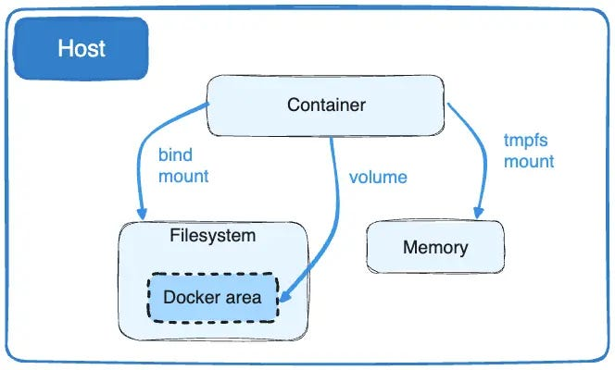
volumes
A Docker volume is a persistent storage space that stores data for Docker containers. Docker manages volumes, which are created and stored on the Docker host
https://medium.com/@AbbasPlusPlus/docker-volumes-explained-adc5bf89d5df

Slide 8
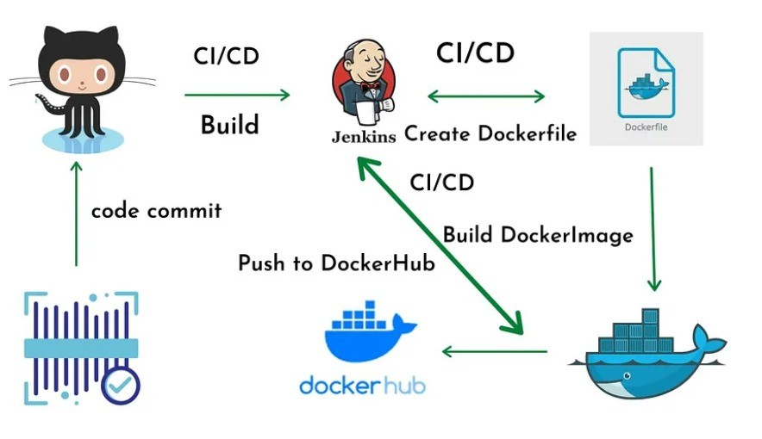
build & run
How to build & run docker
https://www.linkedin.com/pulse/use-your-docker-build-run-knowledge-nikita-parmar/

Slide 9
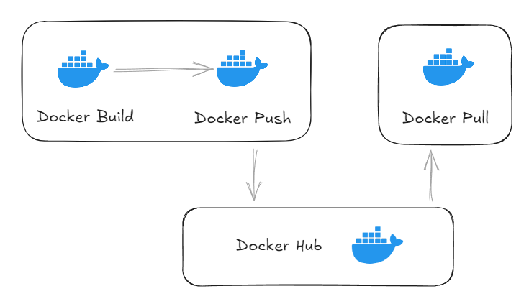
push docker to docker hub
https://dev.to/nodeshiftcloud/how-to-push-docker-image-to-docker-hub-5040

Slide 10
Advanced Docker Concepts
Docker Compose
Manage multi-container applications
Docker Networking
Connect multiple containers
Docker Volumes
Persist data inside containers
Docker Swarm/Kubernetes
Scale and orchestrate containers

